Slide 1




Largest glass manufacturer in Asia – we developed “Glocal” = “Global template + Localization” sales channel model to improve their OI margin
BASIC MATERIALS (GEM) | ASIA-PACIFIC
BAS021
Client Context
Approach
Impact
Largest glass manufacturer in Japan with over $13 Billion in sales
Key issue: Solve sales channel conflict and increase sales coverage
ILLUSTRATIVE
Design “Glocal” sales channel program
Sales channel conflict
Design global template of sales channel manage-ment
Conduct quick diagnostics to develop strategy
+5p.p.
Conflict
Sales channel
Develop glocal sales channel strategy with key levers
Own sales
Select from global template
Identify gap between global and local sales channel
End customer
Objective
Understand current situation of the client and develop strategy
Design basic models for the client
Define the closest template for each country based on each situation
Under- stand the gap to design local strategy
Adopt key levers to implement glocal sales channel strategy
Lack of sales coverage
Current OI margin
Increase profit by less dis-count
Increase profit by gaining more wallet-share
Target OI margin
Own sales
End customer
Our sales have channel conflict with our sales channel
Our sales don’t have enough sales coverage
Expected output
Diagnostics results of current situation
Template of Global sales channel strategy
Selected basic sales channel model for each country
Diagnos- tics results of local situation (market, competitor, company)
Glocal sales channel strategy
In the past, we were categorized as a competitor from our sales channel. Now we can develop true partnership model with them

Slide 2
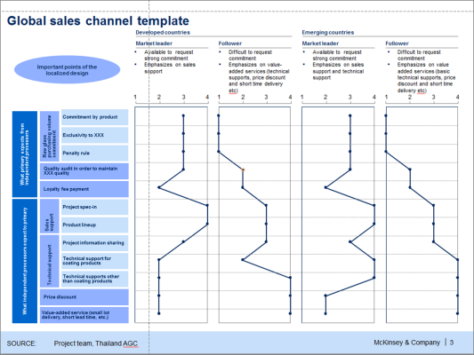
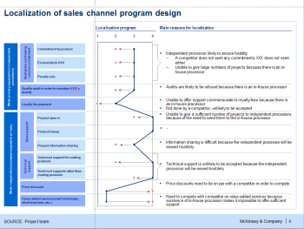
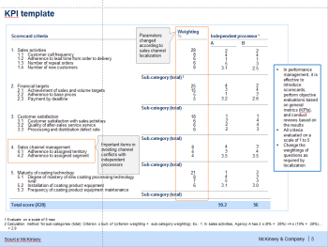
We have developed key tools to design the clients “Glocal” sales channel strategy
CASE STUDIES
Global template of sales channel management
“Glocal” sales channel program
Simple and structured template
Market maturity
Own positioning
Key for localization
Current relationship with sales channel
Competitors local strategy
Performance dialog
KPI management
Feedback process
Motivation improvement
Incentive program
Class categorization
What primary expects from independent processors
Raw glass purchasing volume commitment
Commitment by product
Exclusivity to XXX
Penalty rule
Quality audit in order to maintain XXX quality
Loyalty fee payment
Performance dialog
What independent processors expect to primary
Sales support
Project spec-in
Product lineup
Set KPI
Project information sharing
Agree KPI
Technical support
Technical support for coating products
Feed-back
Technical supports other than coating products
Price discount
Monitor KPI
Value-added service (short lead time, etc.)

